Slide 1
Mediquery – hospital chatbot
CAPSTONE PROJECT
Presented By:
1. Grishma Gedela - Sir C R Reddy College of Engineering - CSE

Slide 2
OUTLINE
Problem Statement
Proposed System/Solution
System Development Approach
Algorithm & Deployment
Result
Conclusion
Future Scope
References

Slide 3
Problem Statement
Currently, many hospitals face challenges in efficiently handling patient inquiries, scheduling appointments, and providing information about services and facilities. This often leads to long waiting times, miscommunication, and patient dissatisfaction.

Slide 4
Proposed Solution
The proposed system aims to address the challenge of efficiently handling hospital-related queries, scheduling appointments, and providing accurate information about hospital services and facilities. This involves leveraging cloud technologies to ensure effective and real-time responses. The solution will consist of the following components:
Data Collection:
Gather historical data on common hospital queries, including appointment scheduling, service information, and general inquiries.
Utilize other relevant data sources, such as updated service information and emergency contact details.
Data Preprocessing:
Clean and preprocess the collected data to handle missing values, outliers, and inconsistencies.
Extract relevant features from the data that might impact the accuracy and relevance of the chatbot's responses.
Watsonx Assistant Model:
Implement a chatbot model using Watson Assistant to understand and respond to user queries based on historical patterns and available data.
Consider incorporating other factors like user feedback and query history to improve response accuracy and relevance.

Slide 5
Proposed Solution
Deployment:
I deployed the solution on IBM Cloud, ensuring scalability and reliability to handle multiple user queries simultaneously.
I ensured the platform is accessible and responsive, considering factors like server infrastructure, response time, and user accessibility.
The project has been published and is now live.
Evaluation:
Assess the chatbot's performance using appropriate metrics such as response accuracy, user satisfaction, and query resolution time.
Fine-tune the watsonx assistant model based on feedback and continuous monitoring of of response accuracy and effectiveness.
Result:
Improved efficiency through reduced waiting times and improved patient satisfaction with quick and accurate responses to queries.
User-friendly interface that is easy to use for both patients and hospital staff, enhancing the overall user experience.

Slide 6
System Approach
System requirements
Libraries Required to Build the Model :
Watson Assistant: For building and managing the chatbot.
IBM Cloud: For deploying and integrating the chatbot with IBM Cloud services.
APIs: For integrating with hospital systems and databases.
Data Preprocessing Tools: For cleaning and organizing data to ensure accurate and relevant responses
Machine Learning Libraries: For improving the chatbot's responses based on user interactions and feedback
Deployment Requirements
IBM Cloud Account: For deploying and managing the chatbot.
Web Server: To host the chatbot interface.
Internet Connection: For accessing IBM Cloud and other online services.

Slide 7
Algorithm & Deployment
Algorithm Selection:
Watson Assistant: MediQuery uses Watsonx Assistant to interpret and respond to user queries.
Data Input:
User queries about hospital services, appointments, and general information.
Training Process:
Trained using sample queries related to hospital services to improve accuracy and response quality.
Prediction Process:
Uses user queries to provide accurate and timely responses.
Data can be updated regularly to ensure the responses remain current and accurate.

Slide 8
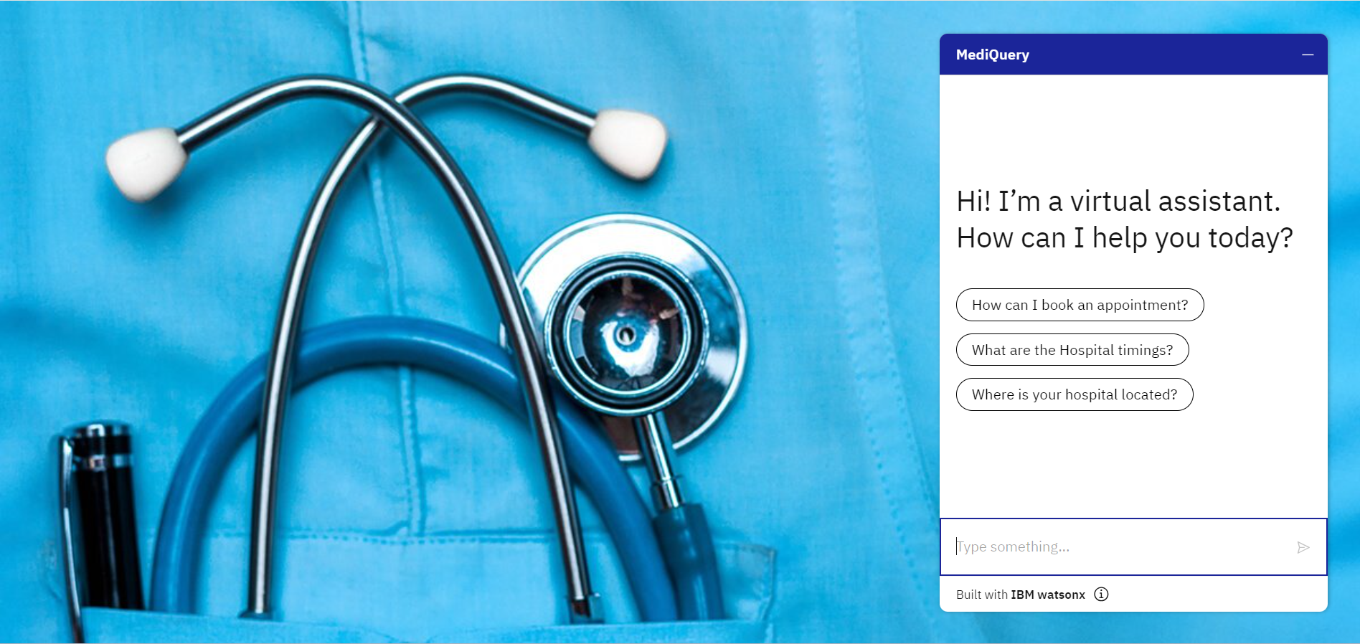
Result

Slide 9
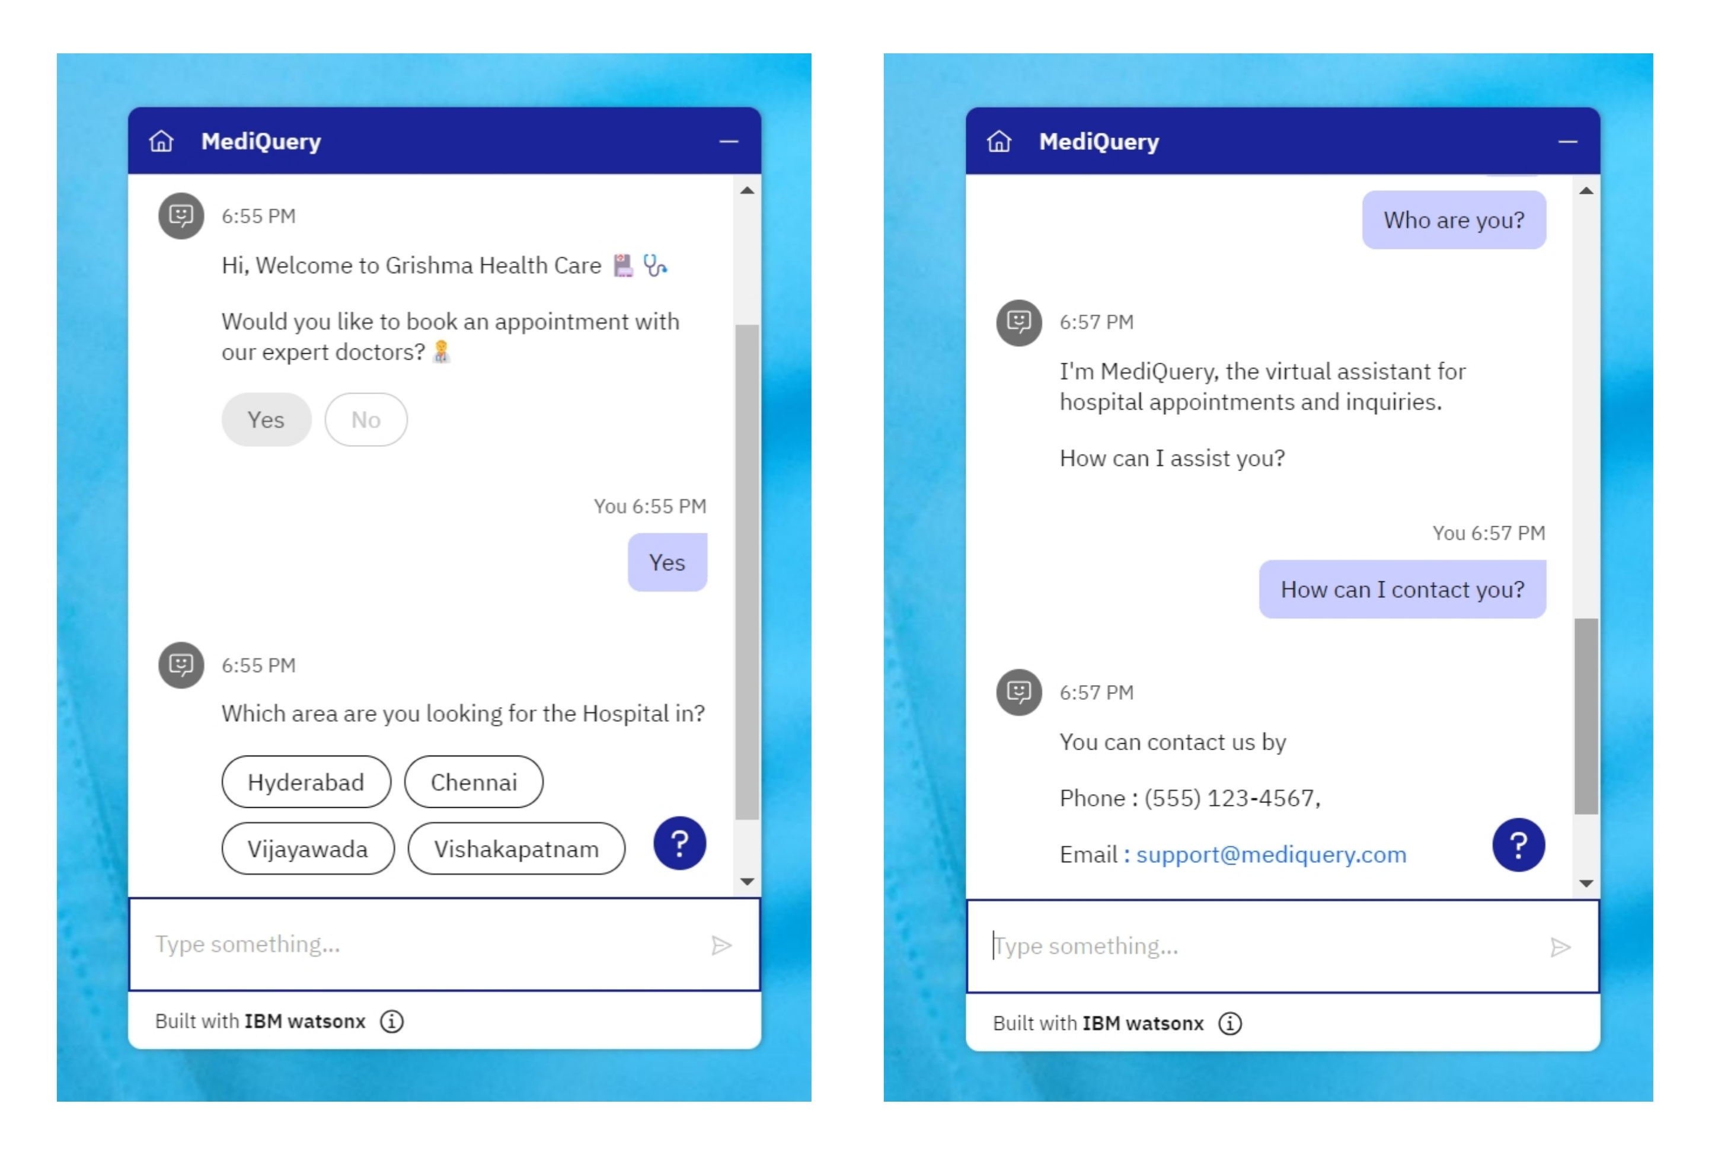

Slide 10
Conclusion
Effectiveness: MediQuery has shown to be an effective tool in managing hospital queries and appointments.
Challenges: Ensuring continuous updates and training to handle a wide range of queries.
Importance: Plays a critical role in enhancing the patient experience and improving hospital operations.

Slide 11
Future scope
Enhancements: Incorporating voice recognition and multilingual support.
Expansion: Extending the chatbot to include more hospitals and healthcare facilities.
Integration: Connecting with more hospital systems for a seamless experience.

Slide 12
References
GitHub Link : https://github.com/grishma-gedela/MediQuery-Hospital-Chatbot.git
IBM Watson Assistant Documentation : https://www.ibm.com/products/watsonx-assistant
IBM Cloud Documentation : cloud.ibm.com

Slide 13
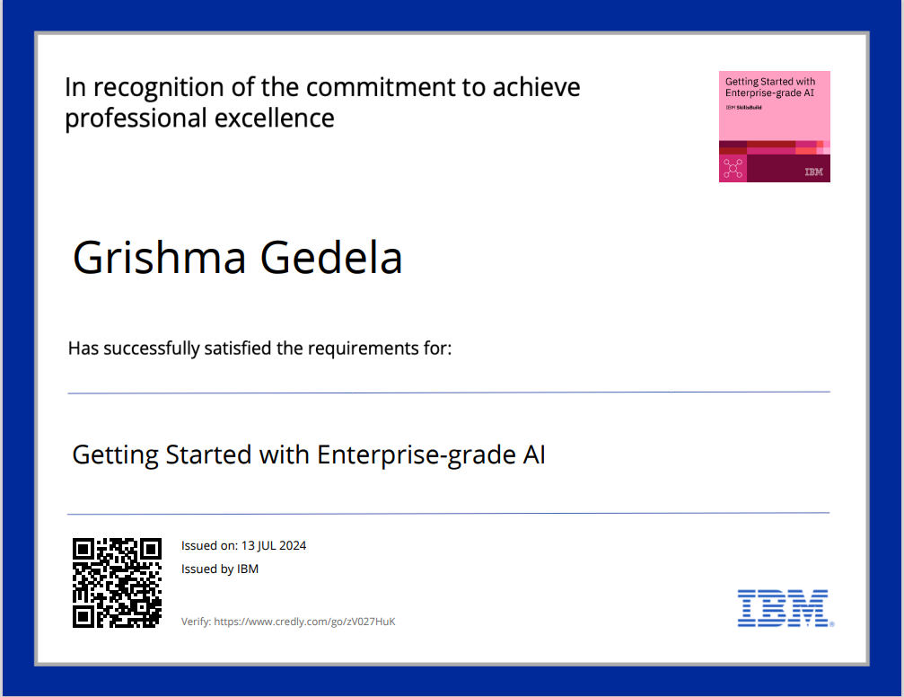
course certificate 1

Slide 14
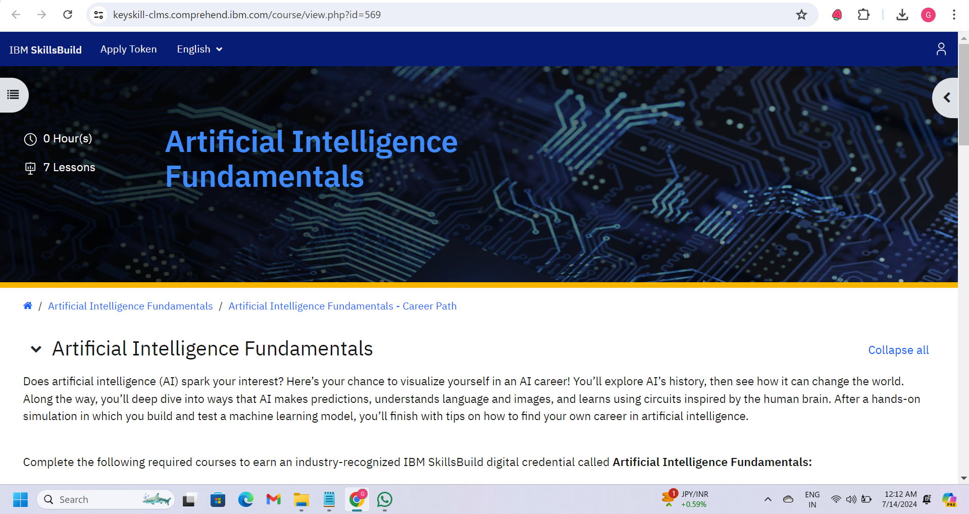
course certificate 2

Slide 15
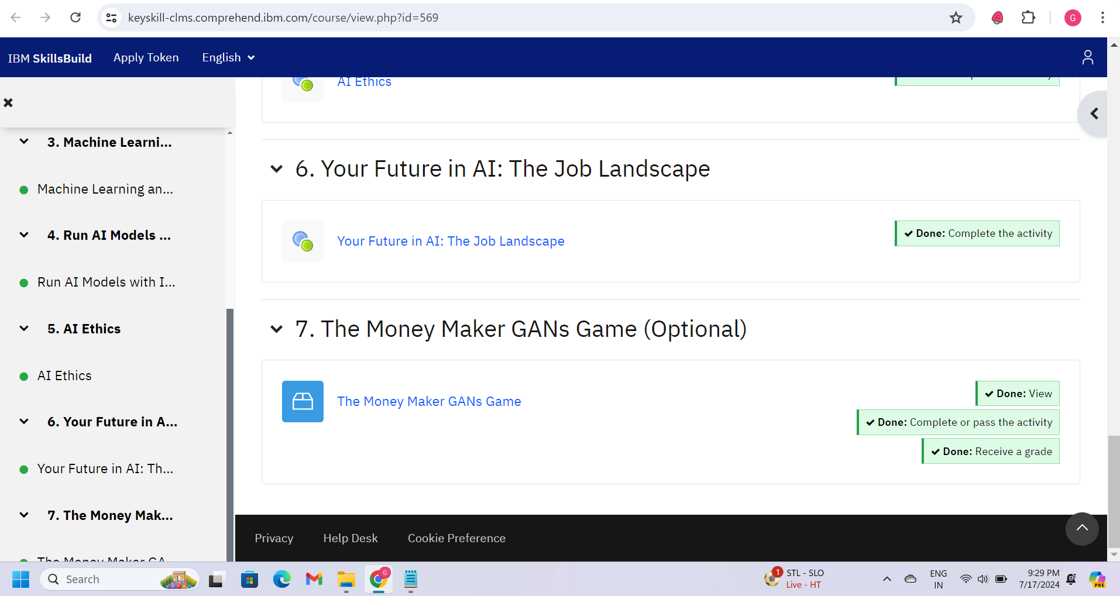
course certificate 2

Slide 16
THANK YOU

